Slide 1
Customer Management Application
By: Saqib Saleem
Student ID: 11648734

Slide 2
Aim of application
This customer management application will be designed for small companies for easy and secure customer management on smartphones and tablets. The company will have the ability to store the customers information Name, Address, Business Phone and Email Address.

Slide 3
Device Capabilities
The device will require Android 5.0 – Lollipop and up. Following are the phone companies that are able to run android 5.0 and up.
Samsung
HTC
LG
Motorola
Google
OnePlus

Slide 4
Target market
It will be designed for small to medium size business like;
Cafes
Real-estate
Restaurants
Fashion stores
Barber shops

Slide 5
MVC architecture
MODEL | VIEW | CONTROLLER
SQLite | activity_main.xml | MainActivity.class
DatabaseHelper.class | activity_delete.xml | AddDataActivity.class
 | activity_add_data.xml | DeleteDataActivity.class
 | activity_update_data.xml | UpdateDataActivity.class

Slide 6
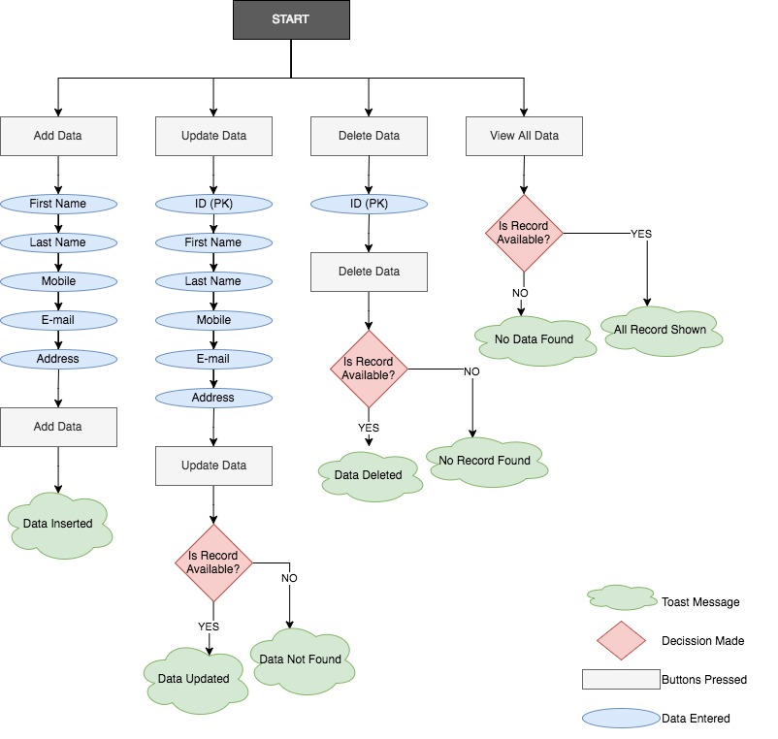
Case Flow diagram

Slide 7
Add data (To play the following video, full screen the slide show and wait for 5 seconds)

Slide 8
Update data (To play the following video, full screen the slide show and wait for 5 seconds)

Slide 9
Delete data (To play the following video, full screen the slide show and wait for 5 seconds)

Slide 10
View all data (To play the following video, full screen the slide show and wait for 5 seconds)

Slide 11
Link to the code is:
https://github.com/SkbSaleem/ITC539-AndroidAppDevelopment/tree/master/CustomerManagementApplication

